Slide 1
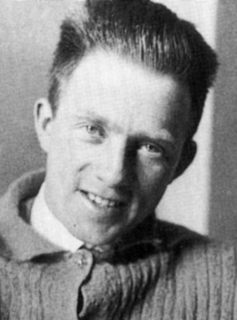
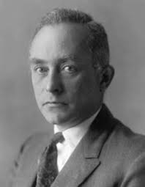
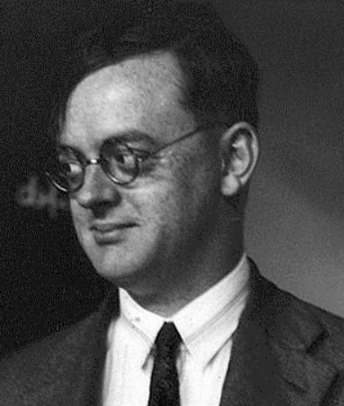
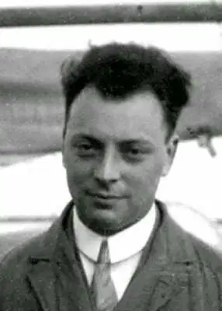
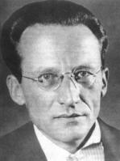
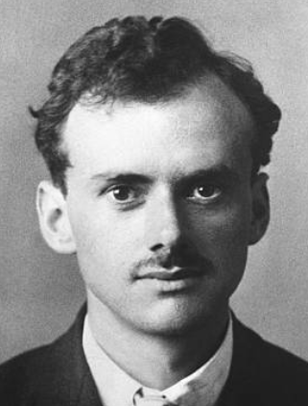
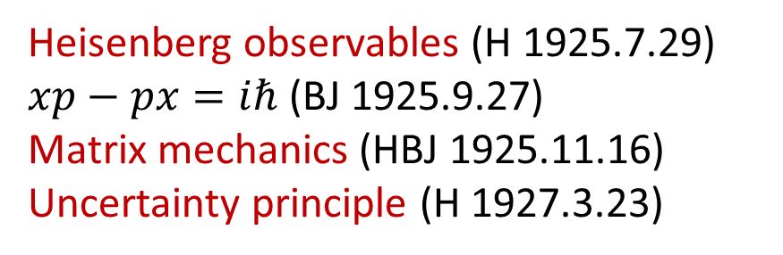
The birth of quantum mechanics
Heisenberg observables (H 1925.7.29)
$xp−px=iℏ$ (BJ 1925.9.27)
Matrix mechanics (HBJ 1925.11.16)
Uncertainty principle (H 1927.3.23)
Heisenberg Born Jordan
Pauli
Solved the Hydrogen levels using Matrix mechanics (1926.1.17)
Schrödinger
Wave mechanics 1926.1.27
The meaning of wave function (Born 1926.7.20)
Dirac
  Classical-Quantum relation 1925.11.7
  Relativistic quantum mechanics (Dirac EQ) 1928.1.2
  《The principle of quantum machanics》1930
Notes:
海森伯：量子力学不回答“如果不做观察，客观上将是怎样的”这类问题，而只回答“如果做某种观察，结果将是怎样的”
波恩：“爱因斯坦的观点又一次引导了我。他曾经把光波振幅平方解释为光子出现的几率密度, 从而使粒子和波的二象性成为可以理解的。这个观念马上可以推广到ψ函数上: ∣ψ∣2应是被测到的电子(或其他粒子)的几率密度。”
Dirac “‘What I wanted was statements which could be expressed in terms of equations,’ he said later, ‘and Bohr’s work very seldom provided such statements.”
Max Born, after learning of the Dirac equation, said, "Physics as we know it will be over in six months."

Slide 2

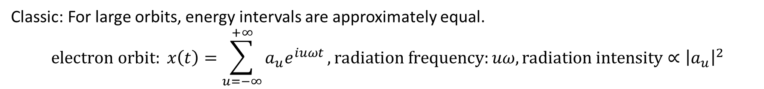
*Heisenberg’s magic (1925.7.29)
Do not assume the non-observable variables have values, such as an electron’s position and velocity.
Describe a physical system only by the observable quantities.
Classic: For large orbits, energy intervals are approximately equal.
$$electron orbit: x\left(t\right)=\sum_{u=−∞}^{+∞}{a_{u}e^{iuωt}}, radiation frequency:uω, radiation intensity∝{\left|a_{u}\right|}^{2}$$
Quantum:
Observables: Frequency $ω\left(m,n\right)=\frac{1}{ℏ}\left[E_{m}−E_{n}\right]$, transition intensity ${∝ \left|a\left(m,n\right)\right|}^{2}$
The quantum form of $x\left(t\right)$ should be expressed by $ω\left(m,n\right)$ and $a\left(m,n\right)$. But its hard to obtain the expression of $x\left(t\right)$ that is symmetrical for $m$ and $n$.
Heisenberg tried ${\left[x\left(t\right)\right]}^{2}$ first
Notes:
海森伯：量子力学不回答“如果不做观察，客观上将是怎样的”这类问题，而只回答“如果做某种观察，结果将是怎样的”

Slide 3
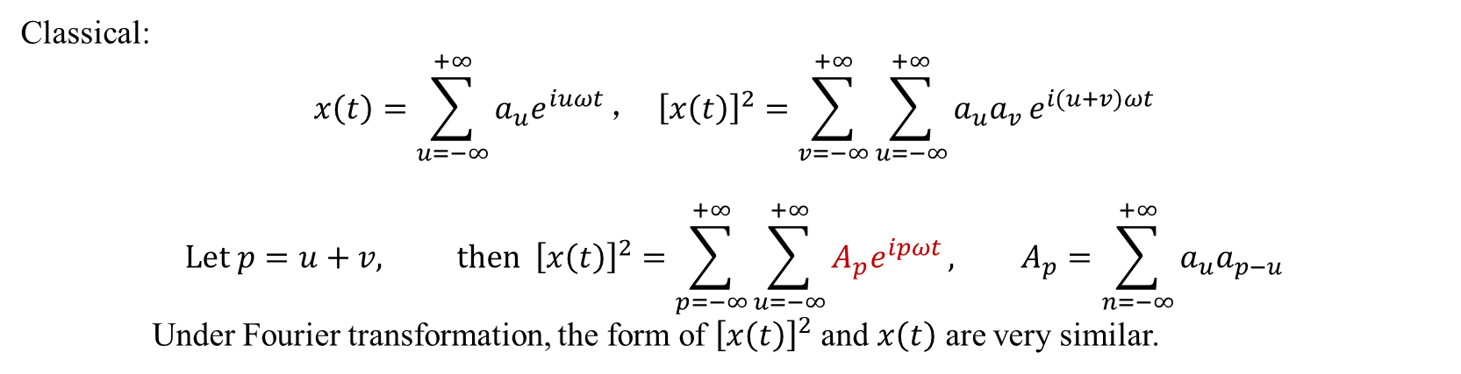
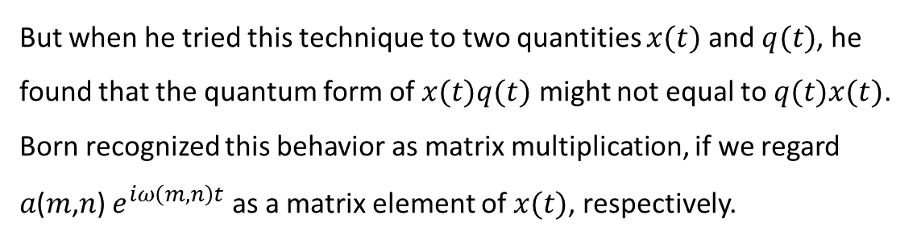
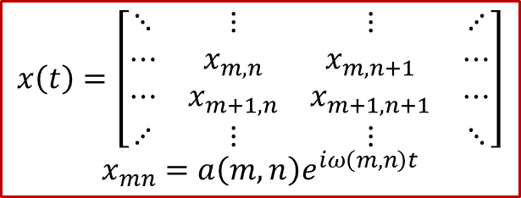
Classical:
$$x\left(t\right)=\sum_{u=−∞}^{+∞}{a_{u}e^{iuωt}}， {\left[x\left(t\right)\right]}^{2}=\sum_{v=−∞}^{+∞}{\sum_{u=−∞}^{+∞}{a_{u}a_{v }e^{i(u+v)ωt}}}$$
$$Let p=u+v, then {\left[x\left(t\right)\right]}^{2}=\sum_{p=−∞}^{+∞}{\sum_{u=−∞}^{+∞}{A_{p}e^{ipωt}}}, A_{p}=\sum_{n=−∞}^{+∞}{a_{u}a_{p−u}}$$
Under Fourier transformation, the form of ${\left[x\left(t\right)\right]}^{2}$ and $x\left(t\right)$ are very similar.
Quantum: What is the quantum form of $A_{p}$ ?
Using Ritz combination principle: $ω\left(m,n\right)=ω\left(m,j\right)+ω(j,n)$, Heisenberg guess the quantum form of $A_{p}e^{ipωt}$
$$A\left(m,n\right)e^{iω\left(m,n\right)t}=\sum_{j=−∞}^{+∞}{a\left(m,j\right)e^{iω\left(m,j\right)t}a\left(j,n\right)}e^{iω\left(j,n\right)t}\text{, }\text{thus} A\left(m,n\right)=\sum_{j=−∞}^{+∞}{a\left(m,j\right)a\left(j,n\right)}$$
But when he tried this technique to two quantities $x(t)$ and $q(t)$, he found that the quantum form of $x(t)q(t)$ might not equal to $q(t)x(t)$. Born recognized this behavior as matrix multiplication, if we regard 𝑎(𝑚,𝑛) $e^{iω\left(m,n\right)t}$ as a matrix element of $x(t)$, respectively.
$$x\left(t\right)=\left[\begin{matrix}⋱ & ⋮ & ⋮ & ⋰ \\ ⋯ & x_{m,n} & x_{m,n+1} & ⋯ \\ ⋯ & x_{m+1,n} & x_{m+1,n+1} & ⋯ \\ ⋰ & ⋮ & ⋮ & ⋱\end{matrix}\right]$$
$$x_{mn}=a\left(m,n\right)e^{iω\left(m,n\right)t}$$

Slide 4
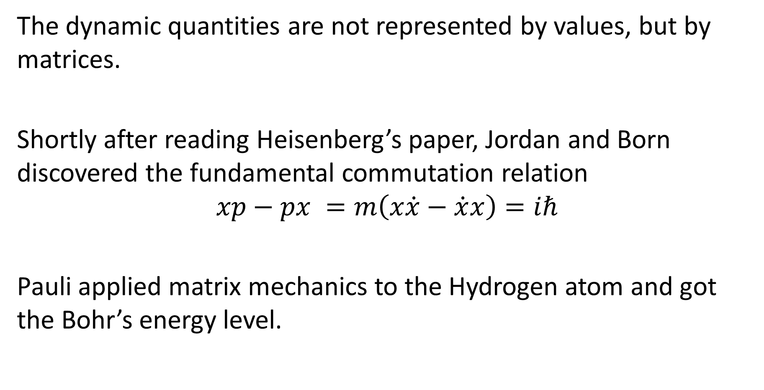
Matrix mechanics
The dynamic quantities are not represented by values, but by matrices.
Shortly after reading Heisenberg’s paper, Jordan and Born discovered the fundamental commutation relation
$$xp−px =m\left(x\dot{x}−\dot{x}x\right)=iℏ$$
Pauli applied matrix mechanics to the Hydrogen atom and got the Bohr’s energy level.

Slide 5
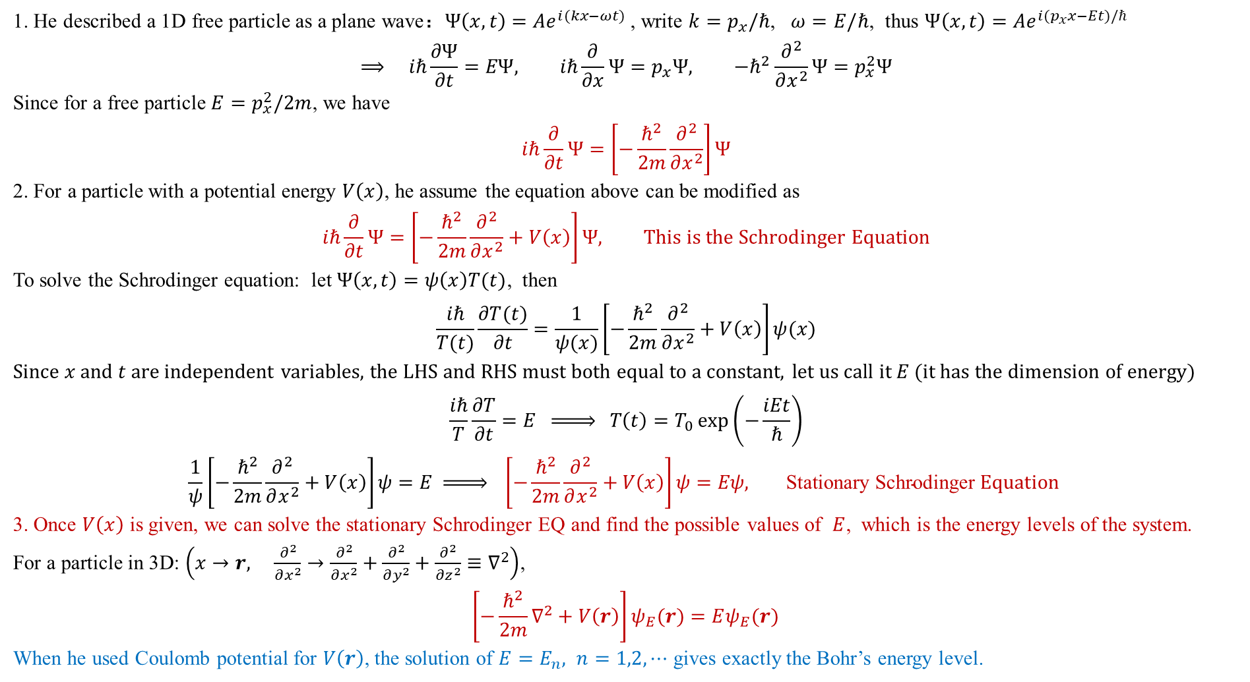
*Schrodinger's wave mechanics
1. He described a 1D free particle as a plane wave：$Ψ\left(x,t\right)=Ae^{i(kx−ωt)}$, write $k=p_{x}/ℏ$, $ω=E/ℏ$, thus $Ψ\left(x,t\right)=Ae^{i(p_{x}x−Et)/ℏ}$
$$⟹ iℏ\frac{∂Ψ}{∂t}=EΨ, iℏ\frac{∂}{∂x}Ψ=p_{x}Ψ, −ℏ^{2}\frac{∂^{2}}{∂x^{2}}Ψ=p_{x}^{2}Ψ$$
Since for a free particle $E=p_{x}^{2}/2m$, we have
$$iℏ\frac{∂}{∂t}Ψ=\left[−\frac{ℏ^{2}}{2m}\frac{∂^{2}}{∂x^{2}}\right]Ψ$$
2. For a particle with a potential energy $V\left(x\right)$, he assume the equation above can be modified as
$$iℏ\frac{∂}{∂t}Ψ=\left[−\frac{ℏ^{2}}{2m}\frac{∂^{2}}{∂x^{2}}+V\left(x\right)\right]Ψ, This is the Schrodinger Equation$$
To solve the Schrodinger equation: let $Ψ\left(x,t\right)=ψ\left(x\right)T(t)$, then
$$\frac{ iℏ}{T(t)}\frac{∂T(t)}{∂t}=\frac{1}{ψ(x)}\left[−\frac{ℏ^{2}}{2m}\frac{∂^{2}}{∂x^{2}}+V\left(x\right)\right]ψ(x)$$
Since $x$ and $t$ are independent variables, the LHS and RHS must both equal to a constant, let us call it $E$ (it has the dimension of energy)
$$\frac{ iℏ}{T}\frac{∂T}{∂t}=E \underset{⇒}{ } T\left(t\right)=T_{0}\exp\left(−\frac{iEt}{ℏ}\right)$$
$$\frac{1}{ψ}\left[−\frac{ℏ^{2}}{2m}\frac{∂^{2}}{∂x^{2}}+V\left(x\right)\right]ψ=E \underset{⇒}{ } \left[−\frac{ℏ^{2}}{2m}\frac{∂^{2}}{∂x^{2}}+V\left(x\right)\right]ψ=Eψ\text{,} \text{Stationary} \text{Schrodinger} Equation$$
3. Once $V\left(x\right)$ is given, we can solve the stationary Schrodinger EQ and find the possible values of $E$, which is the energy levels of the system.
For a particle in 3D: $\left(x→r, \frac{∂^{2}}{∂x^{2}}→\frac{∂^{2}}{∂x^{2}}+\frac{∂^{2}}{∂y^{2}}+\frac{∂^{2}}{∂z^{2}}≡∇^{2}\right)$,
$$\left[−\frac{ℏ^{2}}{2m}∇^{2}+V\left(r\right)\right]ψ_{E}(r)=Eψ_{E}(r)$$
When he used Coulomb potential for $V\left(r\right)$, the solution of $E=E_{n}, n=1,2,⋯$ gives exactly the Bohr’s energy level.
Notes:
德拜：德布罗意的想法似乎过于简单幼稚。既然是波就该有个波动方程
波恩：“爱因斯坦的观点又一次引导了我。他曾经把光波振幅平方解释为光子出现的几率密度, 从而使粒子和波的二象性成为可以理解的。这个观念马上可以推广到ψ函数上: ∣ψ∣2应是被测到的电子(或其他粒子)的几率密度。”

Slide 6
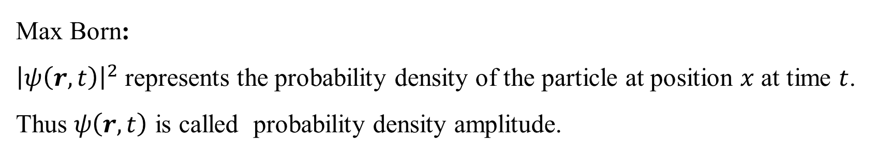
What does $ψ(x,t)$ really mean?
Erwin with his psi can do
Calculations quite a few.
But one thing has not been seen:
Just what does psi really mean
Max Born:
${\left|ψ\left(r,t\right)\right|}^{2}$ represents the probability density of the particle at position $x$ at time $t$.
Thus $ψ\left(r,t\right)$ is called probability density amplitude.

Slide 7
The competition of two mechanics
Matrix mechanics is abstract and difficult to use.
Wave mechanics is relatively intuitive and easier to use.
Schrodinger later proved that these two theories are mathematically equivalent.
Heisenberg disliked wave mechanics. He considered the fact that wave function is a function of position as a violation of his fundamental belief that the trajectory of a particle should be abandoned at all.
As more and more people were turning to wave mechanics, Heisenberg fought back with a new enormous weapon: the uncertainty principle
Notes:
Dirac was famously not bothered by issues of interpretation in quantum theory. In fact, in a paper published in a book in his honor, he wrote: "The interpretation of quantum mechanics has been dealt with by many authors, and I do not want to discuss it here. I want to deal with more fundamental things”

Slide 8

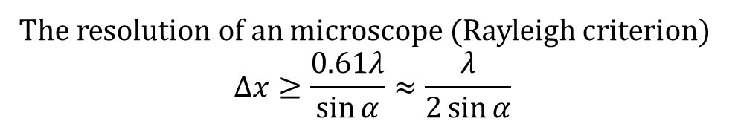



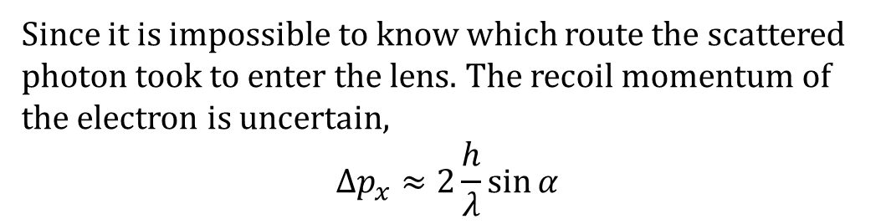
Heisenberg’s Uncertainty principle
Einstein: Aren’t we seeing the trajectories of electron in the cloud chamber?
To answer this question, Heisenberg proposed the following gedanken (thought) experiment
The resolution of an microscope (Rayleigh criterion)
$$∆x≥\frac{0.61λ}{\sin{α}}≈\frac{λ}{2\sin{α}}$$
Since it is impossible to know which route the scattered photon took to enter the lens. The recoil momentum of the electron is uncertain,
$$∆p_{x}≈2\frac{h}{λ}\sin{α}$$
$$α$$
$$x$$
$$λ$$
$$∆x∆p_{x}≥h$$
Using light of smaller wavelength decreases the uncertainty of x, but increases the uncertainty of p. Since it’s impossible to simultaneously determine a particle’s position and momentum, Heisenberg believed we cannot assume that a particle has a precise position and momentum at any time.
*参考：赵凯华 – 2004 – 《光学》，4.4节
Notes:
这个版本是经过玻尔修正过的版本，海森堡再次搞错了显微镜的原理。

Slide 9
It turns out that the viewpoints of Heisenberg and Schrodinger captured two central concepts of quantum mechanics: observable and quantum state (wave function), which respectively correspond to operator (算符) and vector (向量) in linear algebra. ( For a quick review of liner algebra check out the following videos by 3B1B 【官方双语/合集】线性代数的本质 - 系列合集-3Blue1Brown-线性代数-哔哩哔哩视频)
The establishment of quantum mechanics (QM)
  Within the time span of only one year, a burst of breakthroughs by Heisenberg, Born, Jordan, Schrodinger, and Dirac laid the foundation of quantum mechanics
  Revolutionized how we perceive the world
  QM born out of atomic physics, became the overarching principle of modern physics

Slide 10
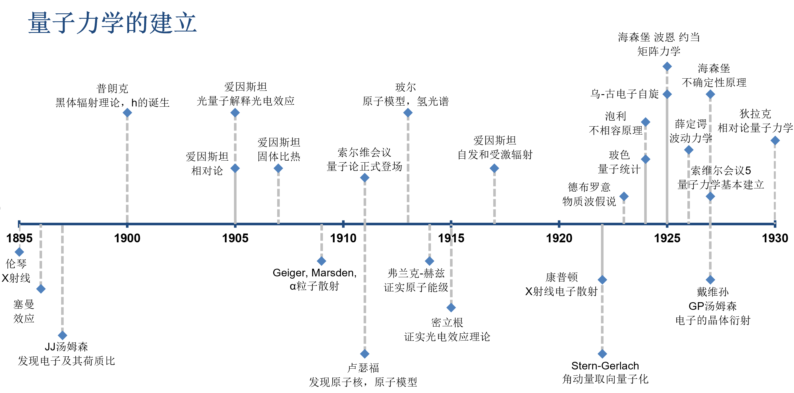
http://faculty.wcas.northwestern.edu/~infocom/Ideas/quantum_timeline.html

Slide 11
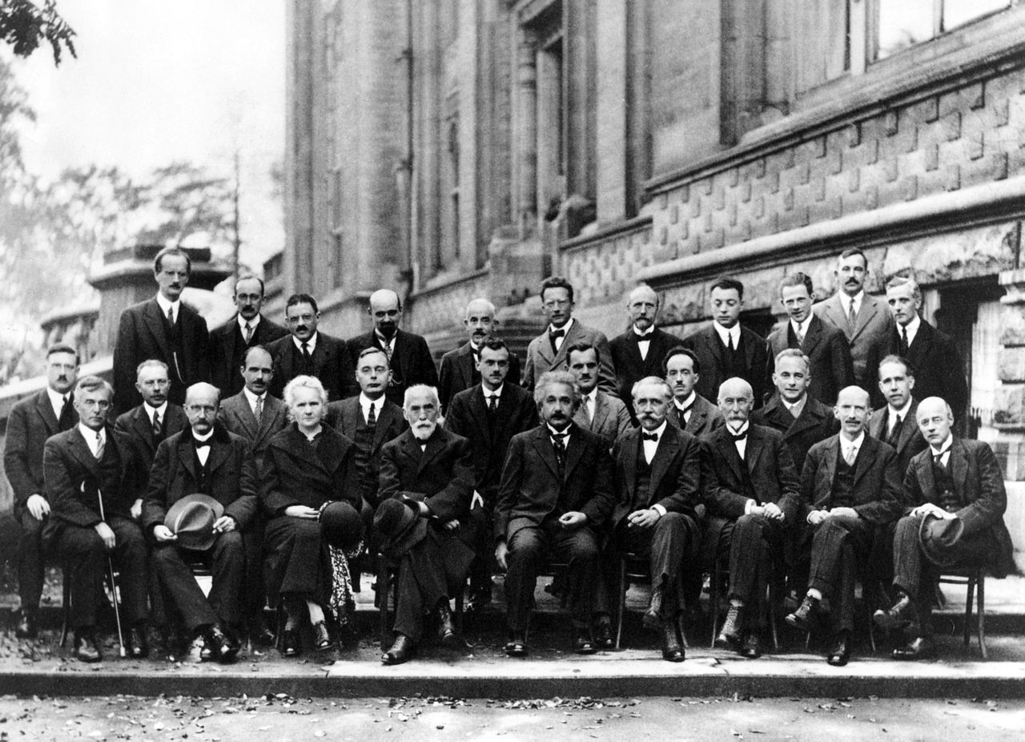
The 5th Solvay Conference 1927: electron and photon
Notes:
A. Piccard, E. Henriot, P. Ehrenfest, E. Herzen, Th. de Donder, E. Schrödinger, J.E. Verschaffelt, W. Pauli, W. Heisenberg, R.H. Fowler, L. Brillouin;
P. Debye, M. Knudsen, W.L. Bragg, H.A. Kramers, P.A.M. Dirac, A.H. Compton, L. de Broglie, M. Born, N. Bohr;
I. Langmuir, M. Planck, M. Skłodowska-Curie, H.A. Lorentz, A. Einstein, P. Langevin, Ch.-E. Guye, C.T.R. Wilson, O.W. Richardson

